Slide 1
Large-scale Incremental Processing Using Distributed Transactions and Notifications
Daniel Peng and Frank Dabek
Google, Inc
OSDI 2010
Presentation: 陈渤、黄思、秦培杰
Demo: 丁峰、徐华韬
Notes:
今天将由我、xx为大家作关于这篇论文的presentation，而demo的演示部分是由丁峰和xx负责。
正如标题所示，这篇文章构建了一个大规模增量数据处理系统，这个系统的核心主要是分布式的xx，google根据这篇文章设计了Percolator系统，用于取代原本基于MapReduce的搜索引擎indexing系统。

Slide 2
Contents
1
Motivation
2
System design
3
Evaluation
4
Conclusion
Notes:
我将从以下4个方面介绍这篇文章，首先讲一下我们要设计这个系统的motivation，然后介绍系统的核心设计思想，接着对系统进行评估，最后对整篇文章进行总结

Slide 3
Contents
1
Motivation
2
System design
3
Evaluation
4
Conclusion

Slide 4
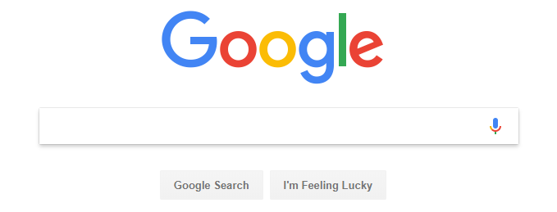
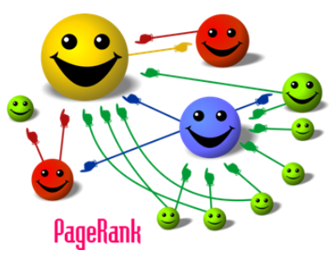
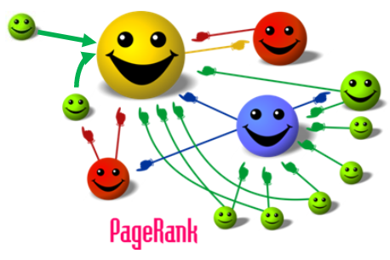
Motivation
Notes:
众所周知，搜索业务是谷歌公司的核心业务之一，搜索引擎需要对全网的页面进行爬取，然后建立index，计算每个页面的pagerank值；当用户请求某个搜索时，根据反向链接检索当前PageRank值高的页面，最终呈现在列表中。假设当前已经爬取并处理完成的网页网络如图所示，当隔一段时间后，搜索引擎会重新抓取一小部分新网页，此时如何更新网页的index呢

Slide 5

Motivation
How to update the index after recrawling some small portion of the web?
Before MapReduce
After Percolator
Process the entire repository, not just the new documents
Discard the work done in earlier runs
Make latency proportional to the size of the repository, rather than the size of an update
An incremental processing system
Avoid redoing work that has already been done
Batch-based indexing system
Incremental-based indexing system
Reduce the average document processing latency by a factor of 100.
Reduce the average age of documents in Google search results by 50%.
Notes:
在这篇文章之前，谷歌所采用的index system是基于MapReduce。
因此，我们设计了percolator

Slide 6
Contents
1
Motivation
2
System design
3
Evaluation
4
Conclusion

Slide 7
System design - Overview
Application
Observer 1
Observer 2
Observer 3
…
Bigtable Tablet Server
RPC
Lock Service
Worker
Timestamp Oracle
Percolator Library
GFS Chunk Server
Percolator is built on the top of Bigtable distributed storage system.
Percolator applications are structured as a series of observers.
Each observer completes a task and creates more work for “downstream” observers by writing to the table.
The observers perform transactions by call library to send read/write RPCs to Bigtable tablet servers.

Slide 8
System design - Overview
Application
Observer 1
Observer 2
Observer 3
…
Bigtable Tablet Server
RPC
Lock Service
Worker
Timestamp Oracle
Percolator Library
GFS Chunk Server
The system also depends on two small services: the timestamp oracle and the lightweight lock service.
All observers are linked into the Percolator worker
Worker scans the Bigtable for changed columns (“notifications”) and invokes the corresponding observers

Slide 9
System design - Bigtable
Feature:
Bigtable presents a multi-dimensional sorted map to users:
keys are (row, column, timestamp) tuples
Bigtable provides lookup, update operations and transactions on each row.
Weakness:
Bigtable does not provide multi-row transactions.
Solution:
Percolator provides APIs similar to Bigtable’s API.
Percolator supports multirow transactions and designs the observer framework.

Slide 10

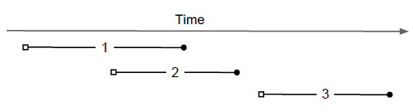
System design - Transactions
Feature:
Provides cross-row, cross-table transactions with ACID snapshot-isolation semantics (protects against write-write conflicts).
Stores multiple versions of each data item using Bigtable’s timestamp dimension.

Slide 11
System design - Transactions
Feature:
Provides cross-row, cross-table transactions with ACID snapshot-isolation semantics (protects against write-write conflicts).
Stores multiple versions of each data item using Bigtable’s timestamp dimension.
Two phase commit, strong consistency.
Stores locks in special in-memory columns in the same Bigtable.

Slide 12
System design - Transactions
Example: Tao transfer $7 to Feng
Bigtable
Transaction() : start_ts_(oracle.GetTimestamp()) {}
Key | Bal: data | Bal: lock | Bal: write
Tao
Feng
Phase1
bool Prewrite(Write w, Write primary) {
Column c = w.col;
bigtable::Txn T = bigtable::StartRowTransaction(w.row);
// Abort on writes after our start timestamp . . .
if (T.Read(w.row, c+"write", [start_ts_, ∞])) return false;
// . . . or locks at any timestamp.
if (T.Read(w.row, c+"lock", [0, ∞])) return false;
T.Write(w.row, c+"data", start_ts_, w.value);
T.Write(w.row, c+"lock", start_ts_,
{primary.row, primary.col}); // The primary’s location.
return T.Commit();
}

Slide 13
System design - Transactions
Example: Tao transfer $7 to Feng
First get timestamp
Bigtable
Transaction() : start_ts_(oracle.GetTimestamp()) {}
Key | Bal: data | Bal: lock | Bal: write
Tao | 6: 5:$10 | 6: 5: | 6:data@5 5:
Feng | 6: 5:$2 | 6: 5: | 6:data@5 5:
Phase1
bool Prewrite(Write w, Write primary) {
Column c = w.col;
bigtable::Txn T = bigtable::StartRowTransaction(w.row);
// Abort on writes after our start timestamp . . .
if (T.Read(w.row, c+"write", [start_ts_, ∞])) return false;
// . . . or locks at any timestamp.
if (T.Read(w.row, c+"lock", [0, ∞])) return false;
T.Write(w.row, c+"data", start_ts_, w.value);
T.Write(w.row, c+"lock", start_ts_,
{primary.row, primary.col}); // The primary’s location.
return T.Commit();
}

Slide 14
System design - Transactions
Example: Tao transfer $7 to Feng
Bigtable
Transaction() : start_ts_(oracle.GetTimestamp()) {}
Key | Bal: data | Bal: lock | Bal: write
Tao | 6: 5:$10 | 6: 5: | 6:data@5 5:
Feng | 6: 5:$2 | 6: 5: | 6:data@5 5:
Phase1
bool Prewrite(Write w, Write primary) {
Column c = w.col;
bigtable::Txn T = bigtable::StartRowTransaction(w.row);
// Abort on writes after our start timestamp . . .
if (T.Read(w.row, c+"write", [start_ts_, ∞])) return false;
// . . . or locks at any timestamp.
if (T.Read(w.row, c+"lock", [0, ∞])) return false;
T.Write(w.row, c+"data", start_ts_, w.value);
T.Write(w.row, c+"lock", start_ts_,
{primary.row, primary.col}); // The primary’s location.
return T.Commit();
}

Slide 15
System design - Transactions
Example: Tao transfer $7 to Feng
Bigtable
Transaction() : start_ts_(oracle.GetTimestamp()) {}
Key | Bal: data | Bal: lock | Bal: write
Tao | 6: 5:$10 | 6: 5: | 6:data@5 5:
Feng | 6: 5:$2 | 6: 5: | 6:data@5 5:
Phase1
bool Prewrite(Write w, Write primary) {
Column c = w.col;
bigtable::Txn T = bigtable::StartRowTransaction(w.row);
// Abort on writes after our start timestamp . . .
if (T.Read(w.row, c+"write", [start_ts_, ∞])) return false;
// . . . or locks at any timestamp.
if (T.Read(w.row, c+"lock", [0, ∞])) return false;
T.Write(w.row, c+"data", start_ts_, w.value);
T.Write(w.row, c+"lock", start_ts_,
{primary.row, primary.col}); // The primary’s location.
return T.Commit();
}
detect conflict

Slide 16

System design - Transactions
Example: Tao transfer $7 to Feng
Bigtable
Transaction() : start_ts_(oracle.GetTimestamp()) {}
Key | Bal: data | Bal: lock | Bal: write
Tao | 7:$3 6: 5:$10 | 7:primary 6: 5: | 7: 6:data@5 5:
Feng | 6: 5:$2 | 6: 5: | 6:data@5 5:
Phase1
bool Prewrite(Write w, Write primary) {
Column c = w.col;
bigtable::Txn T = bigtable::StartRowTransaction(w.row);
// Abort on writes after our start timestamp . . .
if (T.Read(w.row, c+"write", [start_ts_, ∞])) return false;
// . . . or locks at any timestamp.
if (T.Read(w.row, c+"lock", [0, ∞])) return false;
T.Write(w.row, c+"data", start_ts_, w.value);
T.Write(w.row, c+"lock", start_ts_,
{primary.row, primary.col}); // The primary’s location.
return T.Commit();
}
declare primary lock

Slide 17
System design - Transactions
Example: Tao transfer $7 to Feng
Bigtable
Transaction() : start_ts_(oracle.GetTimestamp()) {}
Key | Bal: data | Bal: lock | Bal: write
Tao | 7:$3 6: 5:$10 | 7:primary 6: 5: | 7: 6:data@5 5:
Feng | 7:$9 6: 5:$2 | 7:primary@Tao.bal 6: 5: | 7: 6:data@5 5:
Phase1
bool Prewrite(Write w, Write primary) {
Column c = w.col;
bigtable::Txn T = bigtable::StartRowTransaction(w.row);
// Abort on writes after our start timestamp . . .
if (T.Read(w.row, c+"write", [start_ts_, ∞])) return false;
// . . . or locks at any timestamp.
if (T.Read(w.row, c+"lock", [0, ∞])) return false;
T.Write(w.row, c+"data", start_ts_, w.value);
T.Write(w.row, c+"lock", start_ts_,
{primary.row, primary.col}); // The primary’s location.
return T.Commit();
}
secondary lock

Slide 18
System design - Transactions
Example: Tao transfer $7 to Feng
Second get timestamp
Bigtable
Phase2
Key | Bal: data | Bal: lock | Bal: write
Tao | 8: 7:$3 6: 5:$10 | 8: 7: 6: 5: | 8:data@7 7: 6:data@5 5:
Feng | 7:$9 6: 5:$2 | 7:primary@Tao.bal 6: 5: | 7: 6:data@5 5:
int commit_ts = oracle_.GetTimestamp();
// Commit primary first.
Write p = primary;
bigtable::Txn T = bigtable::StartRowTransaction(p.row);
if (!T.Read(p.row, p.col+"lock", [start_ts_, start_ts_]))
return false; // aborted while working
T.Write(p.row, p.col+"write", commit_ts, start_ts_);
T.Erase(p.row, p.col+"lock", commit_ts);
if (!T.Commit()) return false; // commit point
// Second phase: write out write records for secondary cells.
for (Write w : secondaries) {
bigtable::Write(w.row, w.col+"write", commit_ts, start_ts_);
bigtable::Erase(w.row, w.col+"lock", commit_ts);
}
primary

Slide 19

System design - Transactions
Example: Tao transfer $7 to Feng
Bigtable
Phase2
Key | Bal: data | Bal: lock | Bal: write
Tao | 8: 7:$3 6: 5:$10 | 8: 7: 6: 5: | 8:data@7 7: 6:data@5 5:
Feng | 8: 7:$9 6: 5:$2 | 8: 7: 6: 5: | 8:data@7 7: 6:data@5 5:
int commit_ts = oracle_.GetTimestamp();
// Commit primary first.
Write p = primary;
bigtable::Txn T = bigtable::StartRowTransaction(p.row);
if (!T.Read(p.row, p.col+"lock", [start_ts_, start_ts_]))
return false; // aborted while working
T.Write(p.row, p.col+"write", commit_ts, start_ts_);
T.Erase(p.row, p.col+"lock", commit_ts);
if (!T.Commit()) return false; // commit point
// Second phase: write out write records for secondary cells.
for (Write w : secondaries) {
bigtable::Write(w.row, w.col+"write", commit_ts, start_ts_);
bigtable::Erase(w.row, w.col+"lock", commit_ts);
}
Release all
lock
Release all
lock
primary@Tao.bal
primary@Tao.bal

Slide 20
System design - Transactions
Solution
Percolator takes a lazy approach to cleanup:
when a transaction A encounters a conflicting lock left behind by transaction B, A may
determine that B has failed and erase its locks.
This modification is performed under a Bigtable row transaction, so only one of the cleanup or commit operations will succeed.
Check the primary lock to decide to cleanup or commit.
Write record: commit, roll forward transaction B.
Lock: cleanup, safely erase the lock and roll back transaction B.

Slide 21
System design - Timestamps
Feature:
The timestamp oracle is a server that hands out timestamps in strictly increasing order.
Timestamp requests are batched to decrease RPC’s.
For failure recovery, the timestamp oracle needs to write the highest allocated timestamp to disk before responding to a request.
Notes:
由于两阶段提交需要与timestamp交互2次，因此要求有比较好的可伸缩性。打包请求，减少RPC的次数。

Slide 22
System design - Notifications
Percolator applications are structured as a series of observers:
DocumentExporter
RawDocumentLoader
DocumentProcessor
LinkInverter
Each observer registers a function on a set of columns:
Executed when any row in that column is written.
Use notifications to track and trigger observers:
Dirty cell: cell with observer that need to be run
Message collapsing: only run once if multiple writes to an observed column
Notes:
前面说过，percolator应用是由一组observers组成。下图是前面的Google索引例子：首先抓取文档加载器会抓取文档，并触发文档处理器来索引文档，文档处理器会触发其它的事务，比如文档导出或者链接反转。
每个observers会给它观察的列注册一个function，当任意一行中被观察的列发生写操作，就会执行observer，生成新的事务。
这种一级一级的observer，我们用notification也就是通知来追踪。但是实现通知我们需要解决两个挑战，一个是需要追踪dirty cell脏单元，就是需要触发observer但还没有去触发的单元。另一个是message collapsing，我们不希望每次写被观察的列都触发它的observer，而是当一定周期内多次写这个被观察的列，只运行一次observer提高效率。

Slide 23
System design - Notifications
“notify” Bigtable column: an entry for each dirty cell
Set notify cell after write and remove it after triggering the observer.
Each worker with several threads scans the notify Bigtable column efficiently.
Random portion – bus clumping. A lock or a new random location.
notify
Key | Bal: data | Bal: lock | Bal: write
Bal: ack
“acknowledgment” column: the latest start TS of last observer
Read the observed col. and its ack column before triggering.
If TS_{obs} > TS_{ack}, run the observer and set the start TS to the ack column. If not, do not run.
At most one observer will commit for each notification.
Notes:
为了解决查找dirty cell的问题，提出一个新列Notify，notify列放的是dirty cell的入口。
当事务写入被观察单元时，会设置相应的通知单元，即notify单元。在观察者被触发并且事务提交后，我们移除通知单元。我们只需要扫描相关的notify列就能找到dirty cell。每个Percolator worker都将几个线程专门用于扫描notify列。高效指Percolator会将notify列存储在单独的Bigtable locality group中，那么在notify列上进行扫描时只需要读取数百万个脏单元，而不是数万亿的全部数据cell，使扫描效率更高效。随机指每个线程随机选择tablet的一个key开始扫描notify列，这样可能遇到公交聚集，堵车的时候很多辆公交车是一起到一个站的，前面的车承担了大部分的上下车负载，后面的车就会追上前面的车。为了避免这个问题，Worker在扫描一行前找到一个轻量lock，避免两个线程运行到同一行，但真的线程A遇见线程B了，A就再选个新的随机位置开始扫描。
为了解决message collapsing，添加一个列。这个Ack列放的是该列触发的上一个observer的开始时戳。
当观察列被写入时，Percolator开始一个事务来处理通知。该事务读取观察列及其相应的ack列。如果观察列时戳比ack列时戳大，说明在上一次更新ack后数据再次被写入了，我们就需要运行observer并将ack列设为运行的开始时戳。否则，观察列时戳比ack列时戳小，一个写操作触发的observer已经运行了，所以不再运行它。Ack列使每个通知最多触发一个observer。

Slide 24
System design - Notifications
Other Machine
Observer transaction
5
Scan thread
……
write
Worker
Scan thread
observer
Scan thread
Scan thread
……
notify
ack | write | data | lock | key
 | … | … | … | Feng
 | … | … | … | Tao
 | … | … | … | Jie
4
1
write
2
Observer
start time
Changed
written
3
Notes:
我们来看一下通知的整个工作流程，图中是我们要观察的列，他有单独的notify列。在一个machine中，step 1： 某逻辑对key:Tao的观察列写入新的数据，此时可能会遇到“写/写冲突”，利用之前说的ACID事务处理。写入成功的事务会将新的写记录提交到write列；并同时设置notify列 ，通知此处值已经发生了变化。step 2：worker中各个扫描线程通过前面所说的分工，对notify列进行扫描。step 3：扫描线程发现了第1步中设置的notify列（图中“Changed”），step 4：通知相关的observer来执行后续逻辑，扫描线程需要判断ack列，通过对write列和ack列中时戳的分析，决定是否可以运行observer。若可以，则将新运行的observer的开始时戳写入ack列，以便下次扫描。对应的observer启动，移除 notify cell并开始执行一个新事务。事务中观察者执行自己的计算逻辑，在计算结束后，输出的结果需要写入另一个table（对应step5，此时会遇到和step1类似的写/写冲突）。提交成功的写操作将触发step1，依次循环直至不再写入任何列或没有任何observer需要被触发。

Slide 25
Contents
1
Motivation
2
System design
3
Evaluation
4
Conclusion

Slide 26
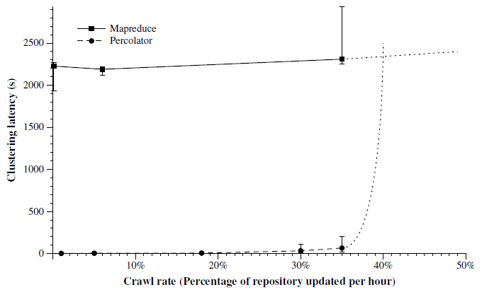
Evaluation
MR vs. Percolator: performance
Percolator: Random lookups
vs
MR: Streaming I/O
Notes:
如图所示，横坐标是抓取率，纵坐标是集群延迟。实线是MR，虚线是percolator。
整个过程MR延迟稳定，当需要抓取少量更新时，Percolator相对MR，延迟要少得多，因为P对抓取的文档进行查找，MR对整个存储库进行处理。随着爬网率上升，percolator会出现一些延迟。而超过35%时延迟骤增，之后两条线都变为虚线，因为都是一个性能推断，不是实际测试。随着文档抓取率接近版本库的大小时，MapReduce的性能会优于Percolator。它们在抓取率较大时的交点是因为：P使用随机查找表，而MR使用流存取，存取相同数据时，流存取性能比随机查找表好，在抓取率较大时，p的增量处理方式不能弥补这种差距。
受到分散程序的限制，MR的延迟变换只在低抓取率时跟抓取率有关。

Slide 27
Evaluation
Latency
- 100x faster than the MapReduce system
Simplification
- The number of observers in Percolator: 10
- The number of MapReduces in the previous system: 100
Tradeoff
- 3x larger repository
- 2x resources
Easier to operate
- Far fewer moving parts: tablet servers, Percolator workers, chunkservers
- Each MapReduce needs to be individually configured and may fail independently
Notes:
处理索引不需再处理整个基础存储库，所以P的基础存储库增加了3倍
更多的资源被用来跟踪系统输入，所以处理相同量的数据，有两倍的资源消耗
更容易实施，更少的的移动部分
数百个MR每个都需要单独配置，每个都可能独立的出错，很麻烦

Slide 28
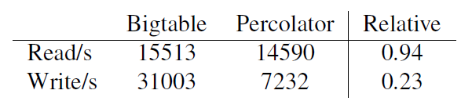
Evaluation
Bigtable vs. Percolator: performance
Write：4x overhead, extra operations beyond the single write
a read to check for locks
a write to add the lock
a second write to remove the lock record
Read：looks at metadata columns in addition to data columns
Notes:
P是在B的架构上实现的，针对在单个tablet server上运行的Percolator和Bigtable
对简单重复读/写单个值比较
B性能优于P，4倍的写开销是因为除了单独的写之外额外的操作：
一次读取检查锁定，一次写入添加锁定，另一次写入删除锁定记录
读有少量性能损失

Slide 29
Contents
1
Motivation
2
System design
3
Evaluation
4
Conclusion

Slide 30
Conclusion
Percolator provides two main abstractions
Transactions: cross-row, cross-table transactions with ACID snapshot-isolation semantics
Observers: triggered by notification
Percolator now building the “Caffeine” web-search index
50% fresher results
3x larger repository
Notes:
P提供了两个架构：具有ACID快照隔离的跨行跨表事务，
P现在用于google的咖啡因索引系统，让用户索引到新网页的速度提升50%，
因为处理索引不需再处理整个基础存储库，所以P的基础存储库增加了3倍

Slide 31
Thank you!

